Slide 1

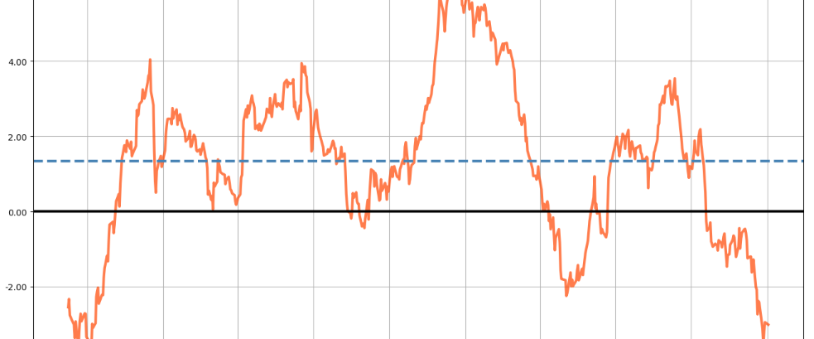
MHI Portfolios
Bu sunuşta izleyeceğiniz tüm veri ve tüm grafikler Yahoo Finance veri tabanının gerçek veriler ile Python dili kullanılarak Alper Ülkü tarafından oluşturulmuştur.

Slide 2
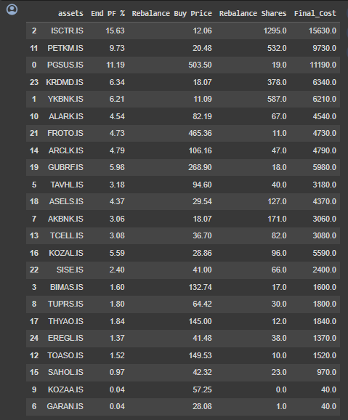
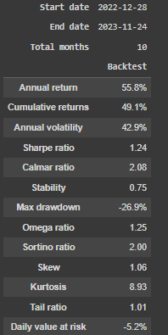
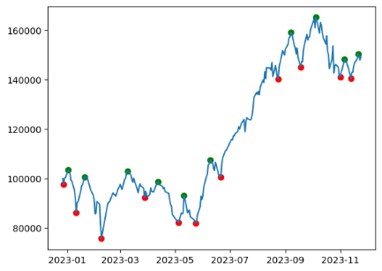
An optimized portfolio for 28.12.2022 – 24.12.2023

Slide 3
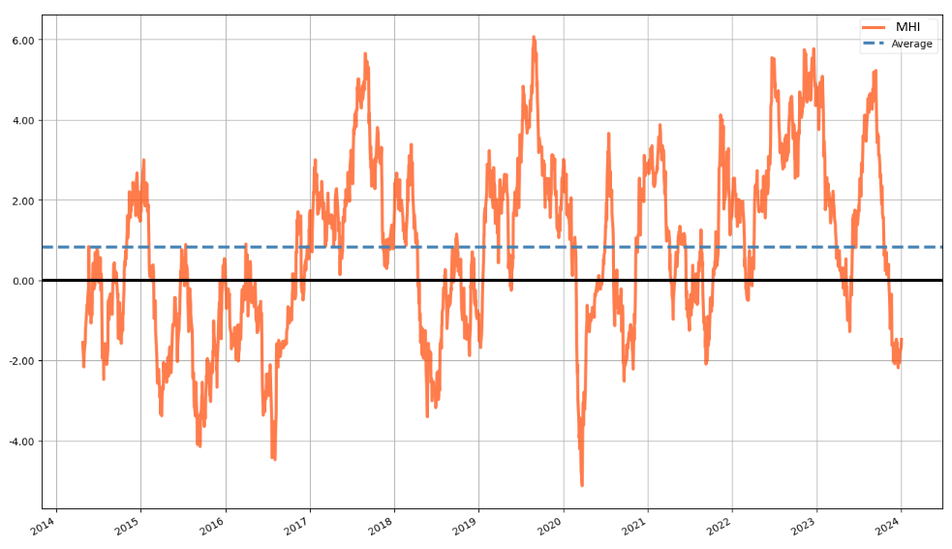
Market Health Index (MHI) - A mean-reverting index for trend detection

Slide 4
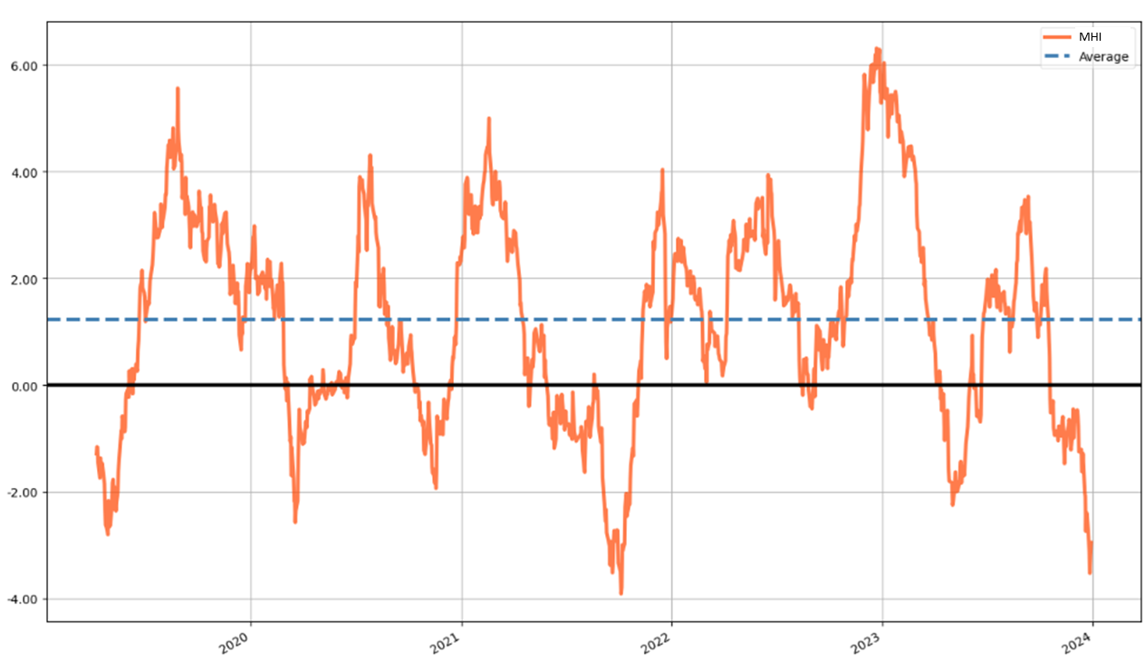
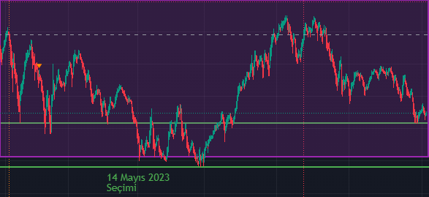
Market Health Index (MHI) - A mean-reverting index for trend detection
MHI on BIST30
Downtrend Uptrend
PREV DOWNTREND PREV UPTREND
23.08.2021 – 21.09.2022 21.09.2021 – 16.12.2021 (I)
16.12.2021 – 24.02.2022 24.02.2022 – 07.06.2022 (II)
07.06.2022 – 16.08.2022 16.08.2022 – 27.12.2022 (III)
27.12.2022 – 09.05.2023 09.05.2023 – 11.09.2023 (IV)
11.09.2023 – 26.12.2023 26.12.2023 – 18.02.2024 (V)
BIST100 – last 1 year
Last 5 years >>

Slide 5
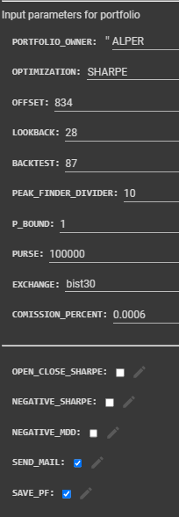
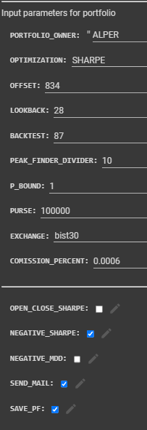
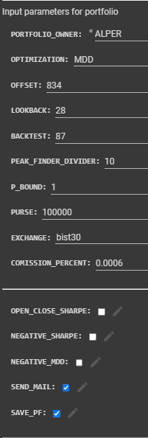
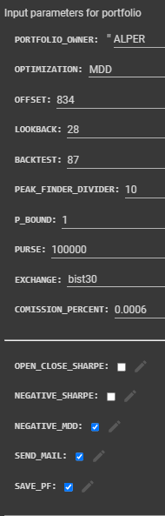
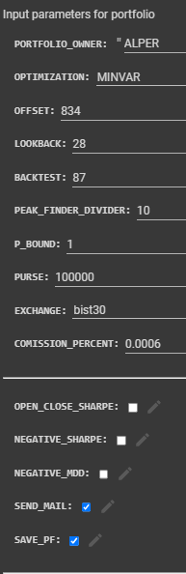
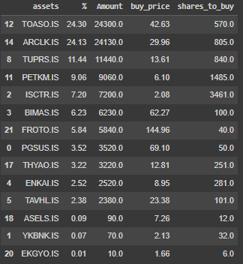
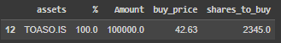
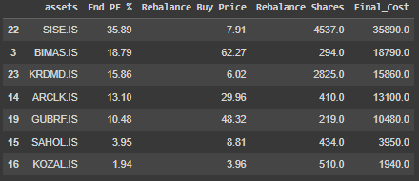
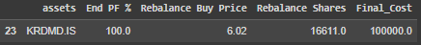
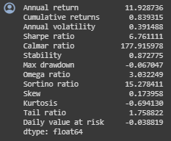
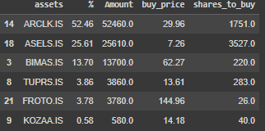
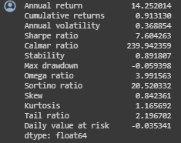
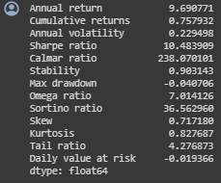
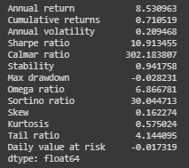
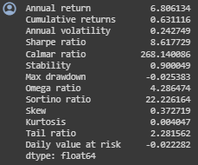
MHI portfolios for 21.09.2021 – 16.12.2021 (I)
Sharpe i-Sharpe MDD i-MDD MINVAR
Return: %91.3
SR: 7.6
MDD: %5.93
Return: %83.9
SR: 6.76
MDD: %6.7
Return: %75.8
SR: 10.48
MDD: %4
Return: %63.1
SR: 8.61
MDD: %2.53
Return: %71.1
SR: 10.91
MDD: %2.82

Slide 6
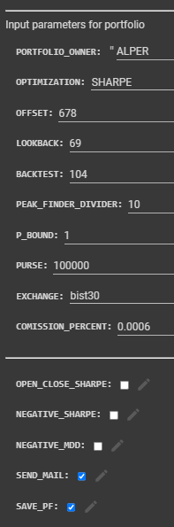
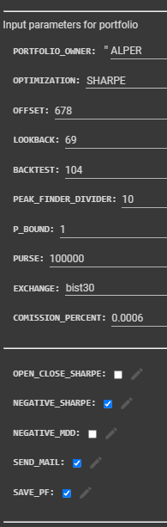
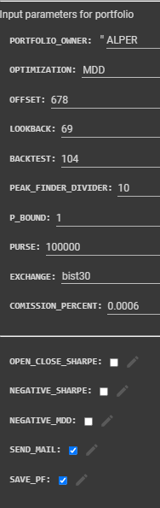
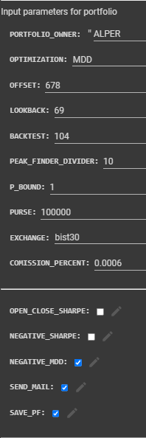
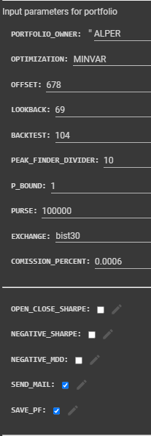
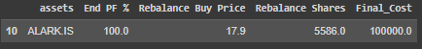
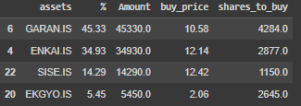
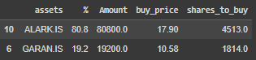
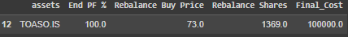
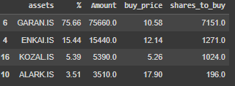
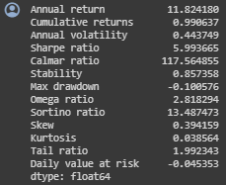
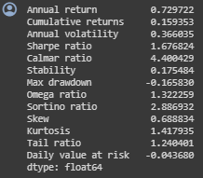
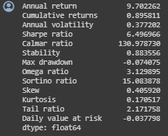
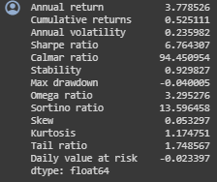
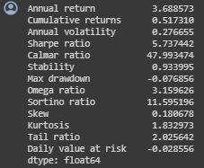
MHI portfolios for 24.02.2022 – 07.06.2022 (II)
Sharpe i-Sharpe MDD i-MDD MINVAR
Return: %99
SR: 5.99
MDD: %10.0
Return: %15.93
SR: 1.67
MDD: %16.58
Return: %89.6
SR: 6.49
MDD: %7.40
Return: %52.5
SR: 6.76
MDD: %4.0
Return: %51.7
SR: 5.73
MDD: %7.68

Slide 7
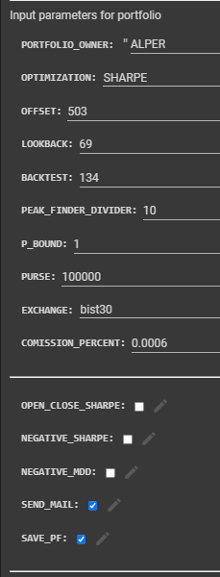
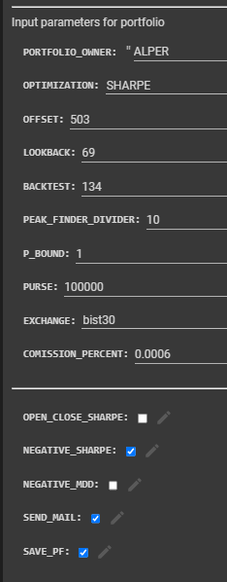
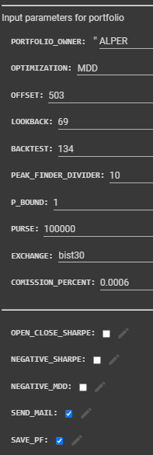
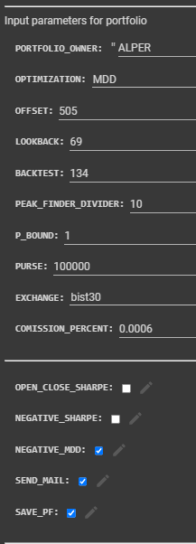
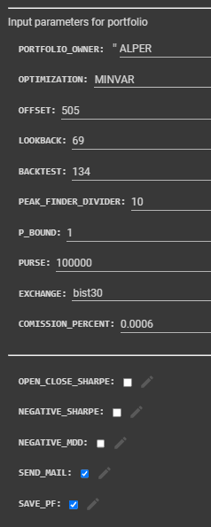
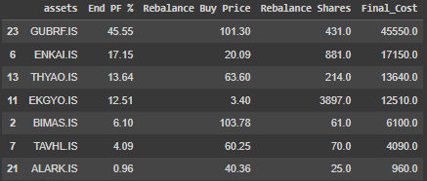
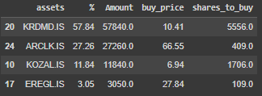
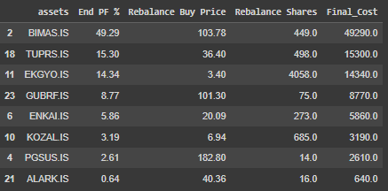
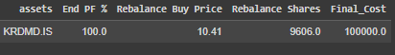
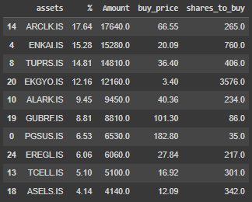
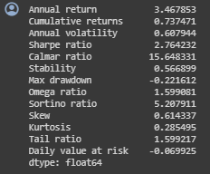
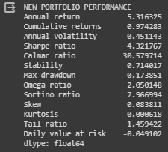
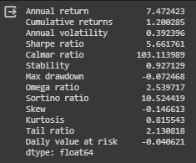


MHI portfolios for 16.08.2022 – 27.12.2022 (III)
Sharpe i-Sharpe MDD i-MDD MINVAR
Return: %73.7
SR: 2.76
MDD: %22.2
Return: %120
SR: 5.66
MDD: %7.2
Return: %97.4
SR: 4.32
MDD: %17.4
Return: %78.7
SR: 4.64
MDD: %9.9
Return: %95.5
SR: 5.96
MDD: %12.0

Slide 8















MHI portfolios for 09.05.2023 – 11.09.2023 (IV)
Sharpe i-Sharpe MDD i-MDD MINVAR
Return: %56.6
SR: 2.75
MDD: %13.7
Return: %65.6
SR: 3.39
MDD: %11.4
Return: %80.4
SR: 3.96
MDD: %16.1
Return: %64.3
SR: 3.96
MDD: %17.8
Return: %92.3
SR: 4.82
MDD: %12.4

Slide 9


PORTFÖY | BAŞLANGIÇ | BİTİŞ | KAR
MHI SHARPE-ALTIN KONSOLİDE | 27.12.2022 | 26.12.2023 | 115,45%
MHI SHARPE-ALTIN KONSOLİDE | 16.12.2021 | 26.12.2023 | 891,79%
MHI SHARPE-ALTIN KONSOLİDE | 21.09.2021 | 26.12.2023 | 1797,30%
MHI MDD-ALTIN KONSOLİDE | 27.12.2022 | 26.12.2023 | 164,57%
MHI MDD-ALTIN KONSOLİDE | 16.12.2021 | 26.12.2023 | 842,53%
MHI MDD-ALTIN KONSOLİDE | 21.09.2021 | 26.12.2023 | 1512,67%
GR ALTIN | 27.12.2022 | 26.12.2023 | 78,25%
GR ALTIN | 16.12.2021 | 26.12.2023 | 126,67%
GR ALTIN | 21.09.2021 | 26.12.2023 | 293,92%
USDTRY | 27.12.2022 | 26.12.2023 | 57,15%
USDTRY | 16.12.2021 | 26.12.2023 | 97,90%
USDTRY | 21.09.2021 | 26.12.2023 | 240,00%

Slide 10
Procedure for Portfolio Construction
Calculate and plot 5 year-MHI
Detect peaks (MHI > 4) and valleys (MHI < -2)
Apply Correlation filter
At the valleys, starting from latest peak calculate portfolio and enter that portfolio.
At the first peak, sell the portfolio.

Slide 11

Filter for Correlation

Slide 12

Filter for Correlation

Slide 13


Filter for Volatility

Slide 14

Robofon portföyleri (downtrend dönemi)

Slide 15

Robohisse portföyleri (downtrend dönemi)

Slide 16


Hisse / Fon uzayı seçimi

Slide 17

Fon bilgileri indir

Slide 18












Robofon portföyleri (uptrend 3 ay)
MINVAR
SHARPE
MDD

Slide 19












Robohisse portföyleri (uptrend 3 ay)
MINVAR
SHARPE
MDD

Slide 20









Robofon portföyleri (downtrend 3 ay)
MINVAR
SHARPE
MDD

Slide 21












Robohisse portföyleri (downtrend 3 ay)
MINVAR
SHARPE
MDD

Slide 22

Our product
AI assisted portfolio generation in Python with
Entry exit based on MHI – mean reverting Market Health Index
Sharpe, i-sharpe, MDD, i-MDD, MINVAR optimized
Correlation volatility, fundamentals and KAP news filtering
Consolidated returns

Slide 23
We should target for the new frontier
Hidden Markov Models
Mean reverting strategies

